Slide 1

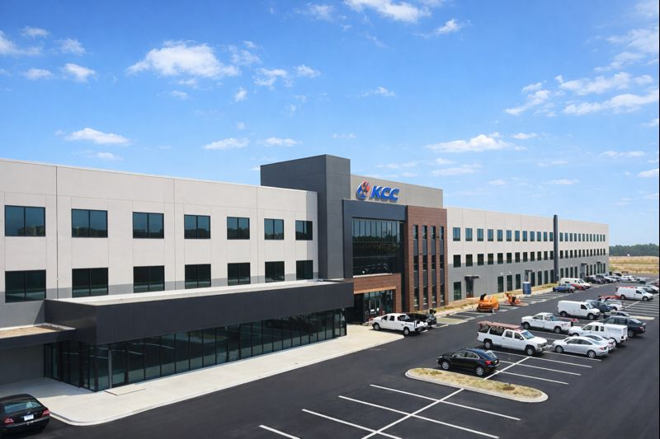



MARCH 2026

Slide 2
Published by: KCC Companies
Newsletter Name: KCC Newsletter
Issue: March 2026 | Issue #3
Frequency: Monthly
Audience: Employees
Produced by: Communications Team
With appreciation to our leadership team and plant managers for their continued support of communication, safety, and growth across KCC.
Additional thanks to the contributions provided by:
Kate Clyde
David Domine
Jeff Thomas
Tracy Palmer
Chris Cook
Gerardo Morena
Jeff Smith
Jeff Balback
Sabrina Phelps
Tammy Mayfield
What’s Inside
Page 1
• Message from the President – On the Front Lines with Joel
• Simpsonville Update
• New equipment Update: TRUMPF Tru Laser 3030
Page 2
• Employee Spotlight – Gerardo Morena
• Plant Spotlight – Technology Drive Plan
Page 3
• Announcements N’ Stuff
• Cook’s Corner
• March Moments That Made History
Page 4
• Operations in Action – Manufacturing Engineering
• January Shipment Performance
• Upcoming Company Survey
Page 5
• February Announcements, Events & Anniversaries
• Upcoming Events
Page 6
• Company Promotions
• Profound Musings…by Craig
Page 7
• Safety Fix of the Month Winners – January 2026
Page 8
• Question of the Month: Where to find Company Info
Page 9
• Pet Spotlight Features
Page 10
• Company Calendar 2026

Slide 3

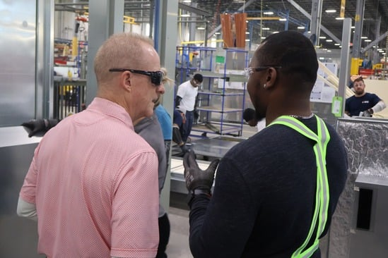
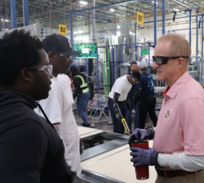
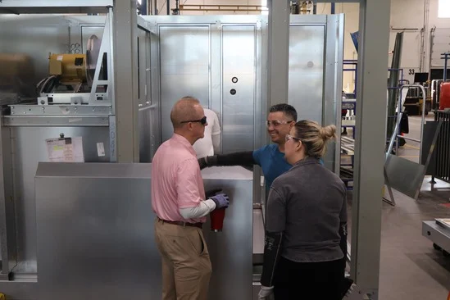
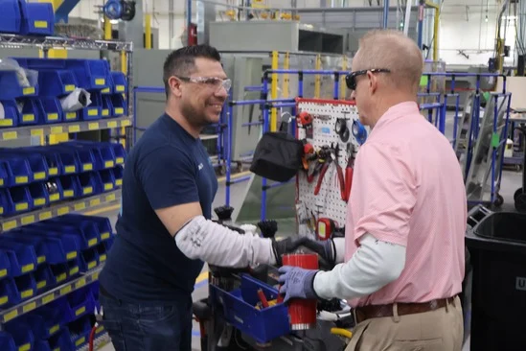
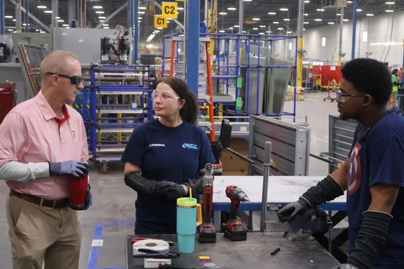
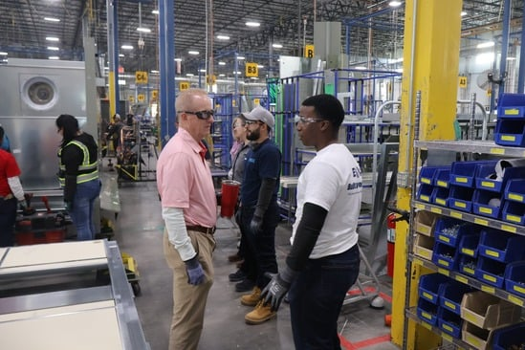
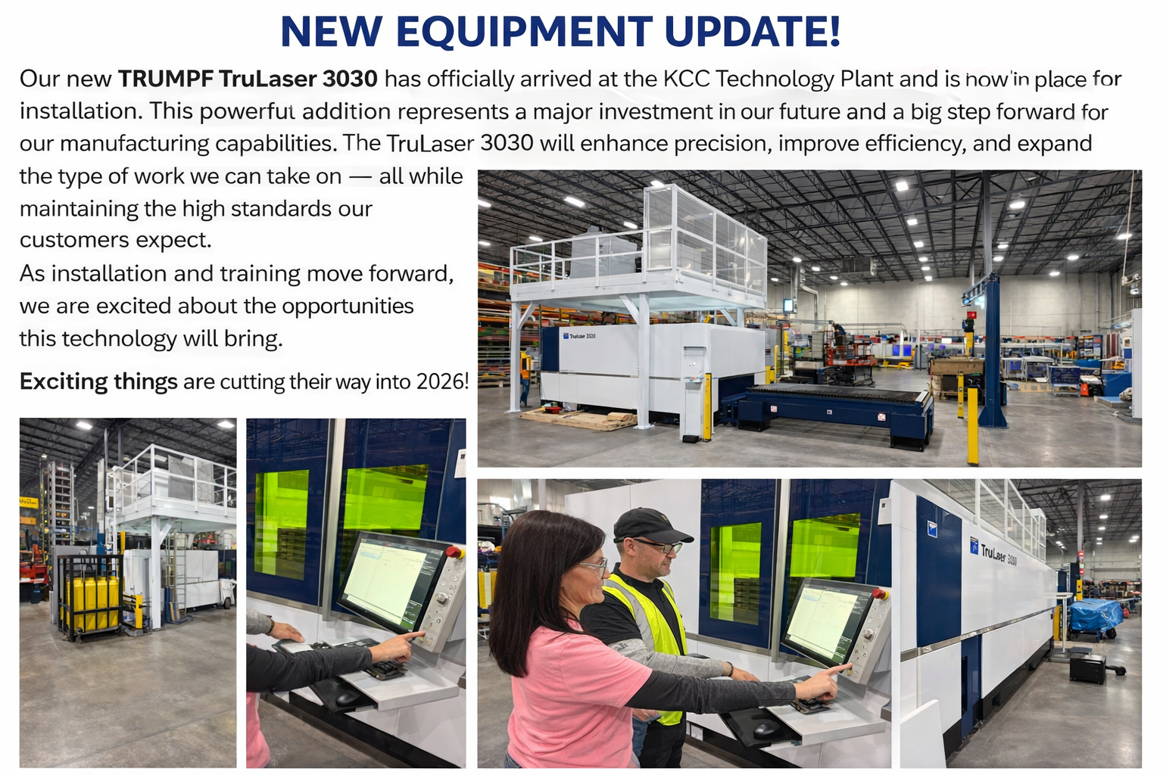
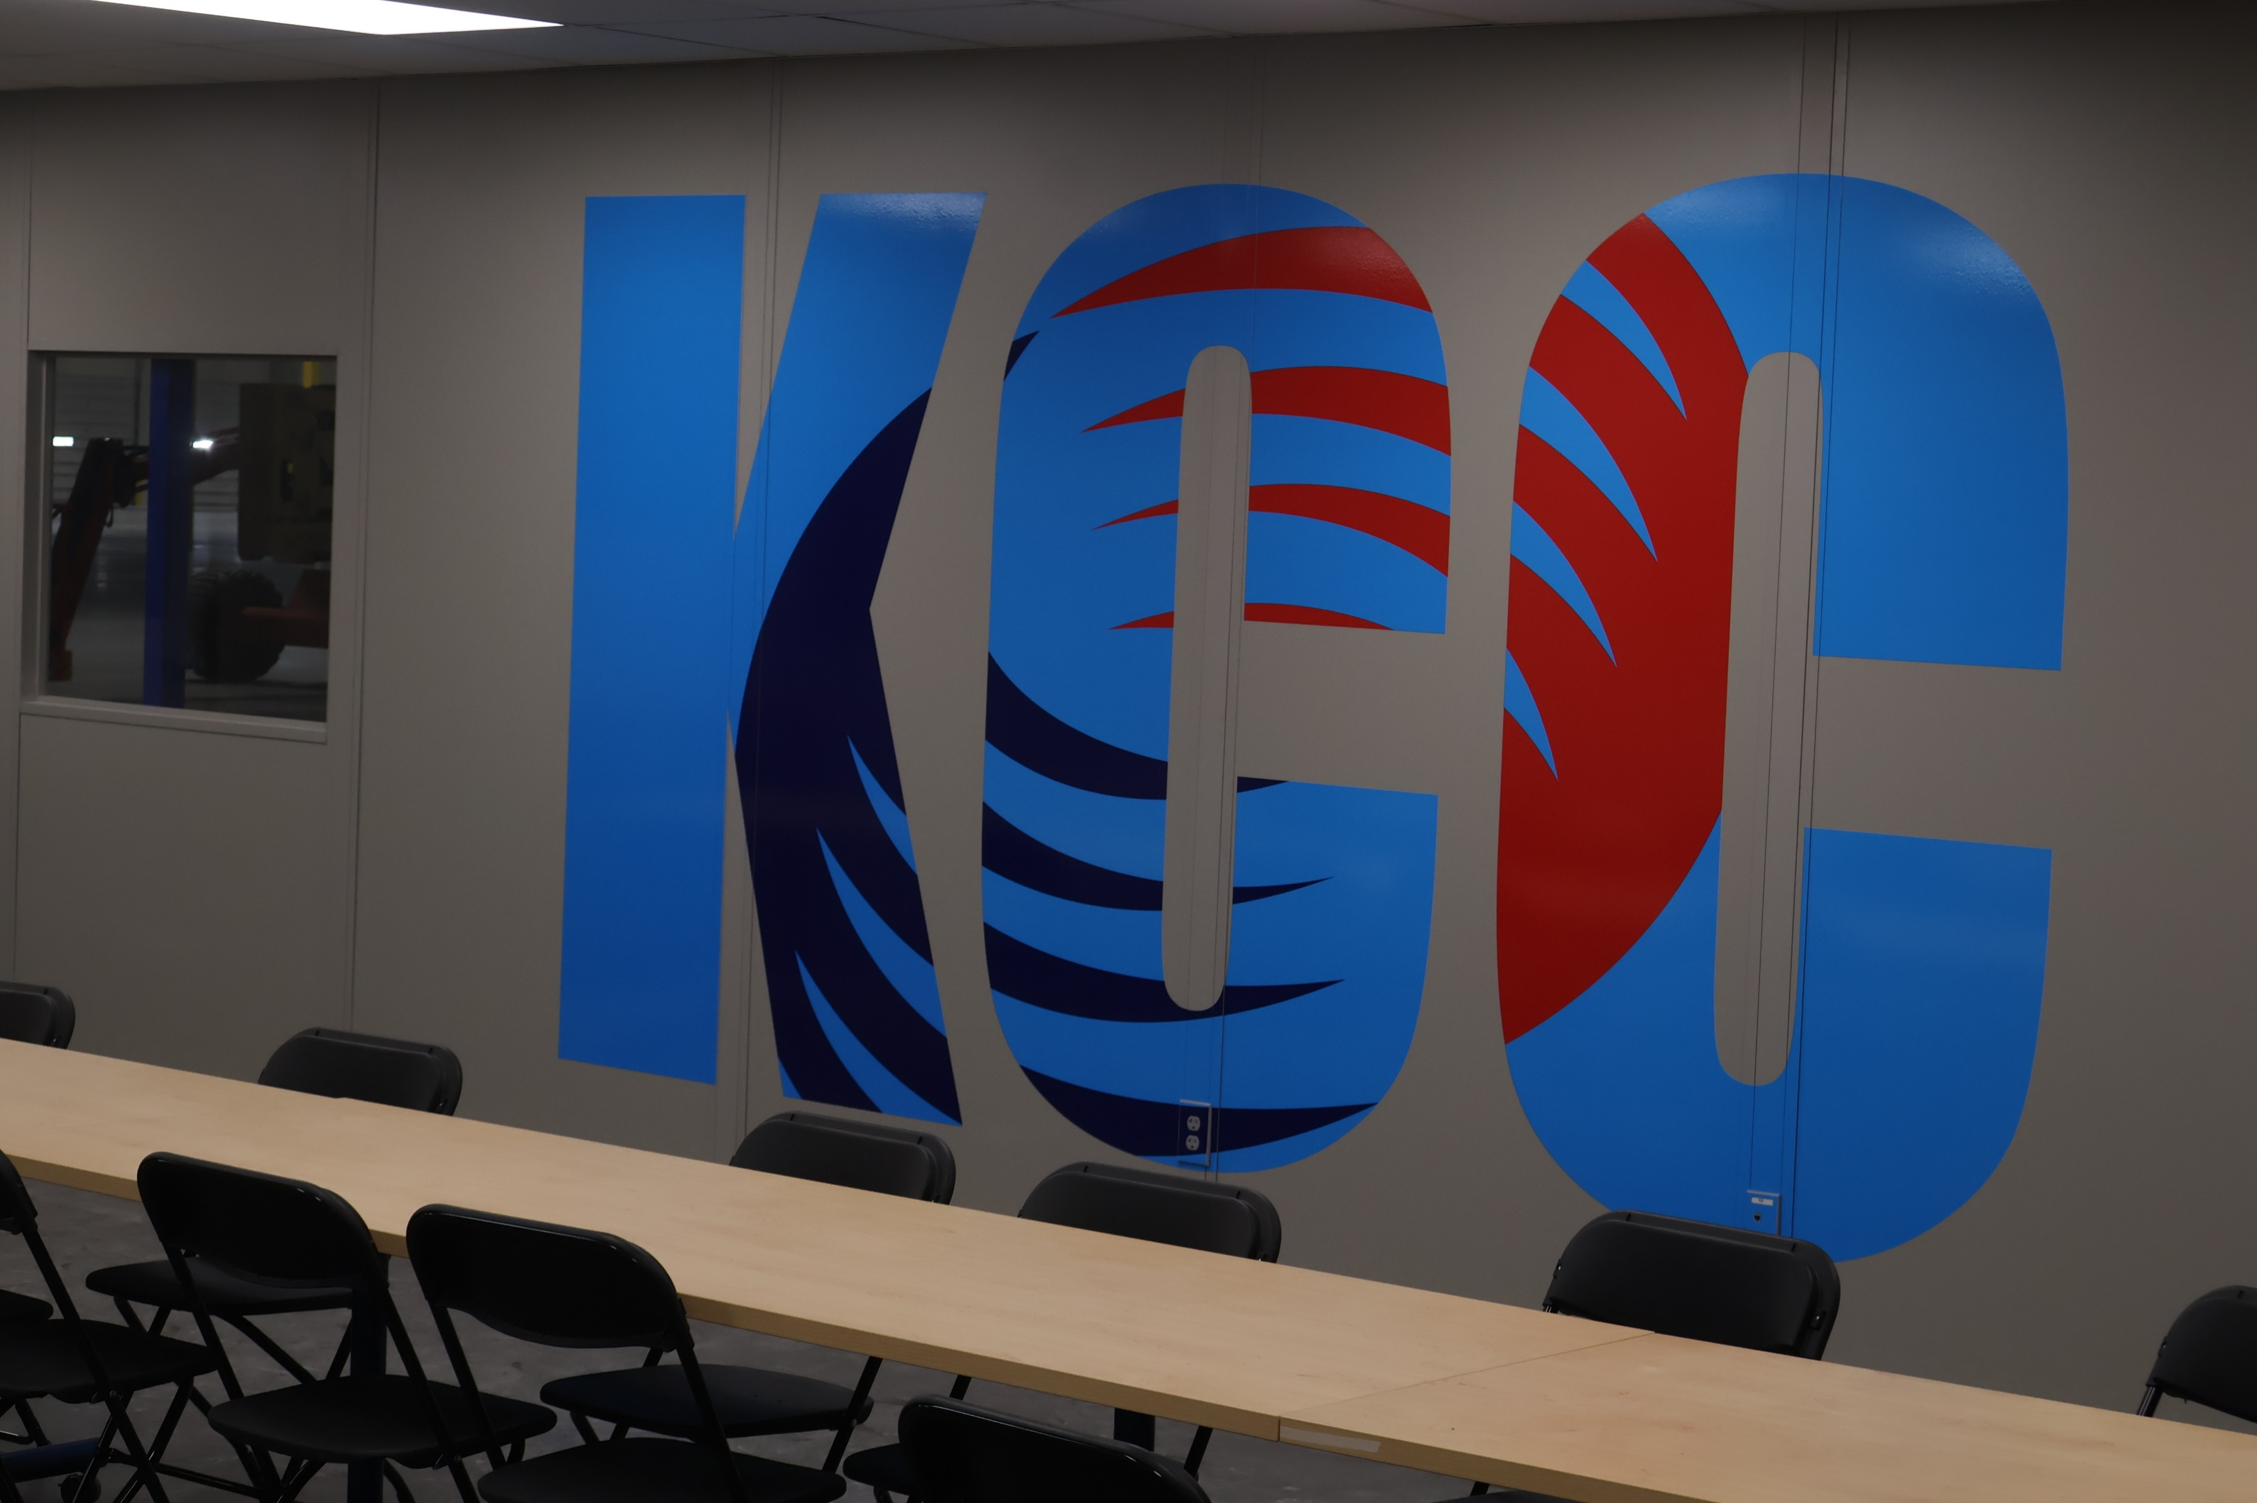

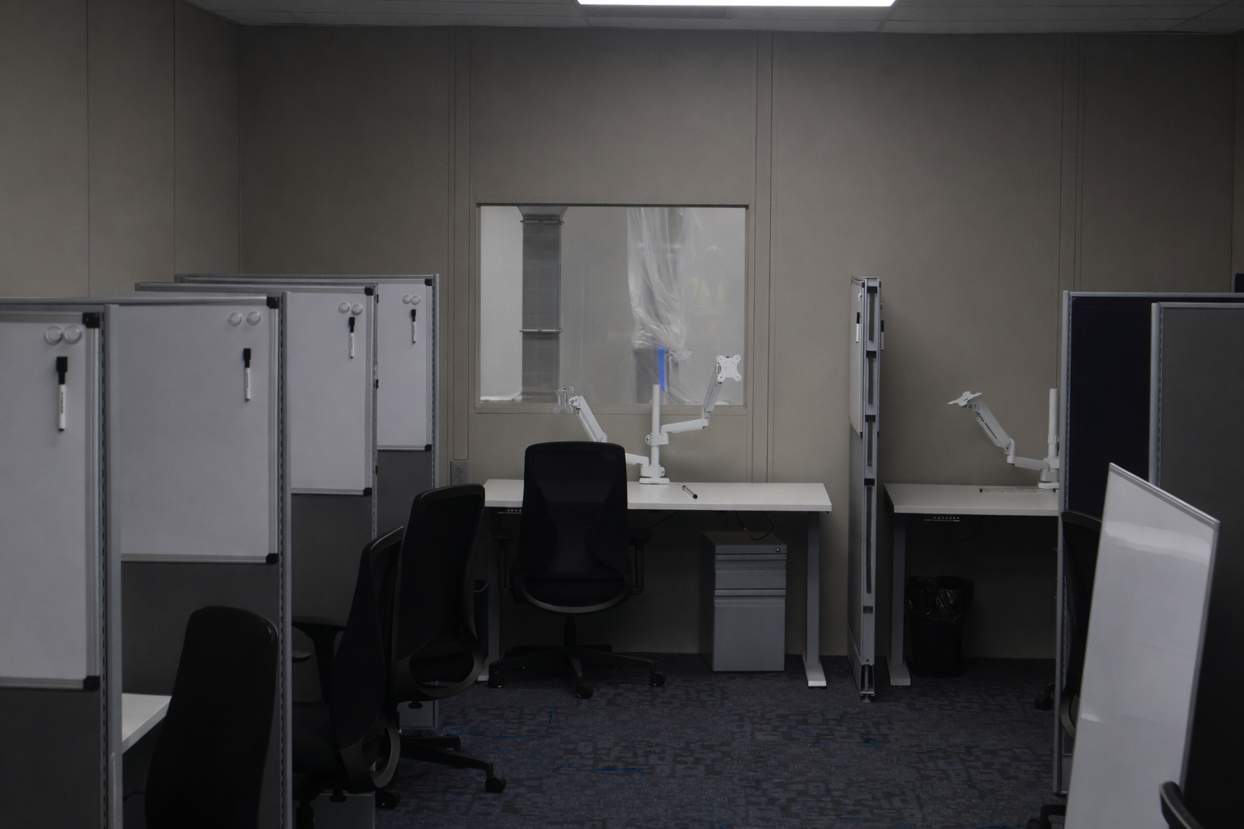
ON THE FRONT LINES WITH JOEL
Joel spent time on the floor last month, connecting directly with the people who power our operations every day. The visit included walking the production lines, observing processes up close, and having open one-on-one conversations
with team members across departments. Employees were encouraged to share ideas, ask questions, and talk about their daily work. Strong teams on the front line drive our success!!
SIMPSONVILLE UPDATE:
There’s a lot of progress happening at our new Headquarters building. Furniture is arriving daily, carpet is being installed in several areas, and the office glass walls are going up. Painting continues throughout the space as we move closer to completion.
Most exciting of all, we’ve had our first employees move into the tower and begin working from the new building. It’s great to see the space being used and coming to life.
Each week brings noticeable progress, and we’re looking forward to sharing more updates as additional teams prepare to move in.
“Work hard in silence. Let success make the noise.” — Frank Ocean
MARCH 2026: ISSUE #3
PAGE 1

Slide 4
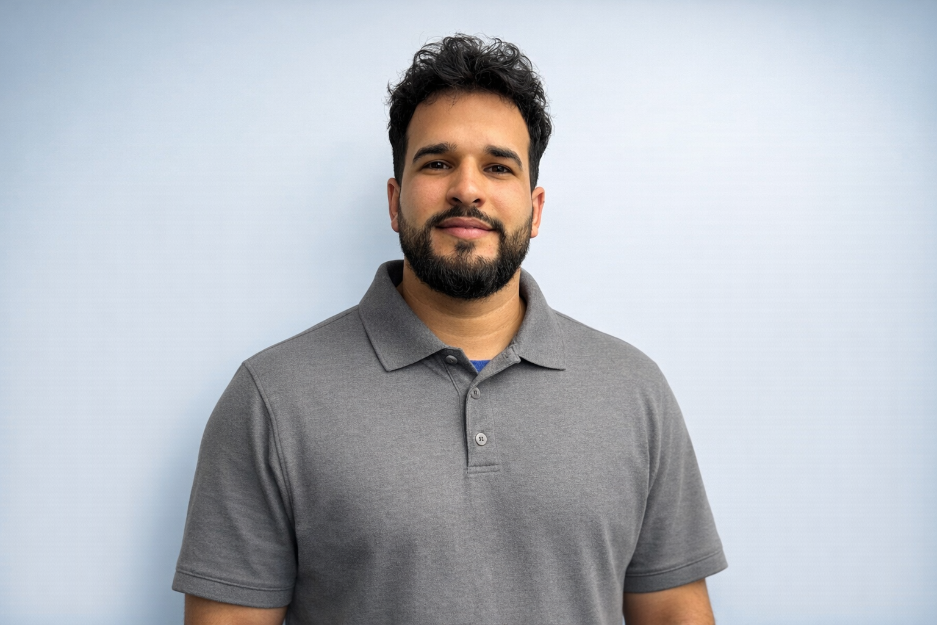
The only place where success comes before work is in the dictionary.
- Vidal Sassoon
EMPLOYEE SPOTLIGHT
Gerardo Morena
Team Leader, Line C
Technology Plant
Years at KCC: 1.5 years
What originally brought you to KCC, and what has kept you here?
I have been at KCC for 1 year and 5 months. I first learned about the company from friends who were already working here. I started in Line C, and I am grateful for the opportunity to now serve as the Team Leader in Technology in a relatively short amount of time.
I enjoy working at KCC because it challenges me to think and create every day. I have stayed because I truly like what I do, and the company gives me opportunities to learn new roles in different areas. I also appreciate that we have an ESOP, which helps us build retirement savings for our future.
What’s your favorite hobby?
My favorite hobby is watching soccer.
If you had a theme song that played when you walked into a room, what would it be?
The song that represents me would be “Thank You” by Don Omar.
What lesson has your time at KCC taught you?
KCC has taught me the importance of responsibility and teamwork.
What advice do you have for new employees?
If you have the opportunity to learn something new, take it! KCC gives you those opportunities — don’t miss them.
PLANT SPOTLIGHT
TECHNOLOGY DRIVE PLAN
1. Key Wins & Highlights
Our OTS improved from 73.75% in Q3 2005 to 97.67% in Q4 2005. In 2025 we produced over $200M in Horizon units for the first time.
We produced a record 3164 Horizon units in 2025.
2. What We’re Working On Now
We have put in five concrete pads at Technology for new Metal Forming equipment. All equipment will be Trumpf. It will include a laser (now installed), stand-alone panel bender and three press brakes with tool changers. The schedule of equipment is not finalized but it started last month and should be complete in June.
3. What’s Coming Next?
We are adding additional 3rd shift areas in Assembly. These areas include Line C and most subassemblies.
We will finish the three NVIRIQ prototype units in February. We hope to start production in March. These units will go down Line A.
4. People & Recognition
There are a lot of additions and movements. We are adding 83 hourly positions total for Metal Forming and Assembly. All positions should be in place by 6/1.
We are adding two supervisor positions in Metal Forming. These supervisors will be on 2nd and 3rd shift and responsible for Foam Injection and Supermarket. We are also adding an Electrical Supervisor to Assembly that will be responsible for electrical work on all four lines, testing and the close area.
SMARTY PANTS FACTS
St. Patrick wasn’t actually Irish.
He was born in Britain (likely Wales or Scotland) in the late 4th century. He was kidnapped by Irish raiders at 16, brought to Ireland, later escaped — and then returned to Ireland as a missionary.
Blue was originally the color associated with St. Patrick — green became popular much later.
MARCH 2026: ISSUE #3
PAGE 2

Slide 5


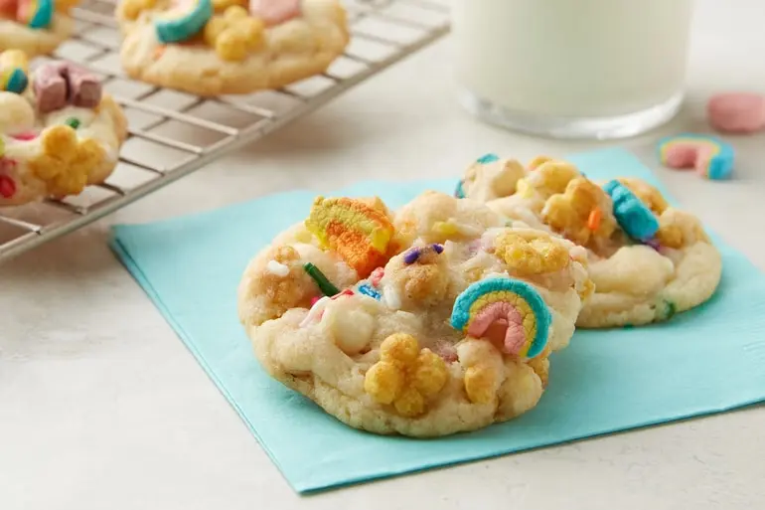

ANNOUNCEMENTS N’ STUFF!
COOK’S CORNER
Magically Delicious Lucky Charms™ Cereal Cookies
Prep time: 15 Minutes
Total time: 1 Hour 20 Minutes
Servings: 36
Calories per serving: 100
Ingredient List
1 pouch (17.5 oz) Betty Crocker™ sugar cookie mix
1/2 cup butter, softened
1 egg
2 cups Lucky Charms™ Honey Clovers cereal
1/2 cup white vanilla baking chips
1 tablespoon rainbow candy sprinkles
ST PATRICK’S DAY IS MARCH 17, 2026
"Top o' the mornin' to ye! Come taste a bit of magic, sure to be better than a pot of gold!"
Preparation
Ah now, gather ‘round and let’s bake up a wee bit o’ magic! 🍀
First off, heat yer oven to a toasty 350°F, so it’s warm as a sunny day in the Emerald Isle. Line yer cookie sheets with parchment paper, nice and tidy like.
In a grand big bowl, stir together the cookie mix, the softened butter (soft as a shamrock petal), and the egg. Give it a good mix ‘til a soft dough comes together. Then toss in the cereal, the baking chips, and a sprinkle o’ sweet candy bits.
Drop the dough by rounded tablespoonfuls onto the cookie sheets, leavin’ about 2 inches between each little mound — give ’em room to jig!
Bake for 9 to 11 minutes, until the edges turn a lovely light golden brown, like a pot o’ gold at the end of the rainbow. Let the cookies rest on the sheet for 1 minute, then move ’em gentle-like to a cooling rack.
Let ’em cool completely — about 30 minutes — if ye can wait that long!
Now there ye have it — sweet treats worthy of a leprechaun’s treasure! 🍪✨
March Moments That Made History
March 10, 1876 – The First Telephone Call is made by Alexander Graham Bell
March 24, 1972 – The Godfather is released in theaters
March 2, 1983 – Michael Jackson’s Thriller album hits #1 (it would become the best-selling album of all time)
March 28, 1992 - Christian Laettner hit his famous buzzer-beater ("The Shot") to defeat Kentucky 104-103 in overtime
MARCH 2026: ISSUE #3
PAGE 3

Slide 6
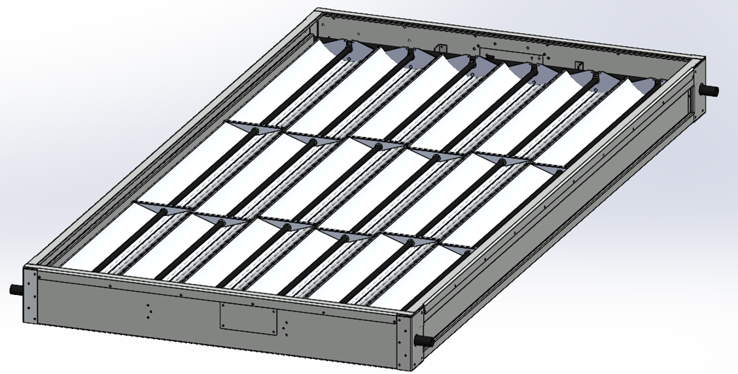
Operations in Action
January Shipment Performance at a Glance
January was a strong start to the year for our team. Across all locations, we shipped a total of $12.76 million in product. This impressive milestone reflects the hard work, coordination, and commitment of our entire organization. Each department played a role in helping us reach this achievement. Thank you to everyone who contributed to making January a success.
Locations | January Shipments
Technology | $10,827,000.00
Grassland | $1,627,000.00
Tooele | $258,000.00
Other (HVAC Service) | $48,000.00
Total | $12,760,000.00
Department Spotlight
UPCOMING COMPANY SURVEY!!!
MANUFACTURING ENGINEERING
1. Key Wins & Highlights
Sabrina Phelps and her team at Grassland (Sebastian Bilbao, Sam Allen & Brandon Moore) have completed the 3rd prototype of the Thermal Collector enclosure for NVIRIQ:
Researched and designed the appropriate rack to unload the glass pallet safely.
Worked with Sandra L. to complete the BOM for Epicor.
Performed 1st article of the machined parts.
Completed final physical layout of the assembly cell.
2. What We’re Working On Now
Sabrina Phelps and her team are preparing to do a complete thermal collector unit with the latest improvements in production simulation.
Testing the painted sheet metal.
Testing the glass-lifting method.
Testing the welding & painting method for the TC housing.
Purchase and deploy the remaining tools needed for production (Rivet guns, tool balancers, etc.).
3. What’s Coming Next
Once production validation is complete, we can put the finishing touches on the processes, work instructions and capacity planning.
4. People & Recognition
Thanks to Sabrina Phelps, Sebastian Bilbao, Sam Allen & Brandon Moore for the Highlights above.
We want to make you aware that KCC will be conducting a company-wide employee survey within the next month (March/April). Our last survey was completed three years ago, and it is time to gather updated feedback from our team members.
This year, the survey process will look a bit different. The survey will be distributed via text message to each employee, and responses will be compiled by department. This approach will allow our Learning & Development (L&D) team to provide meaningful feedback to supervisors and managers.
The results will also help L&D identify future training opportunities and development needs, which we hope will positively impact employee engagement and retention—especially as KCC continues to grow and hire new team members.
Additional details will be shared prior to the survey launch. We simply wanted to make everyone aware that this initiative is coming soon.
Thermal Collector enclosure for NVIRIQ
MARCH 2026: ISSUE #3
PAGE 4

Slide 7



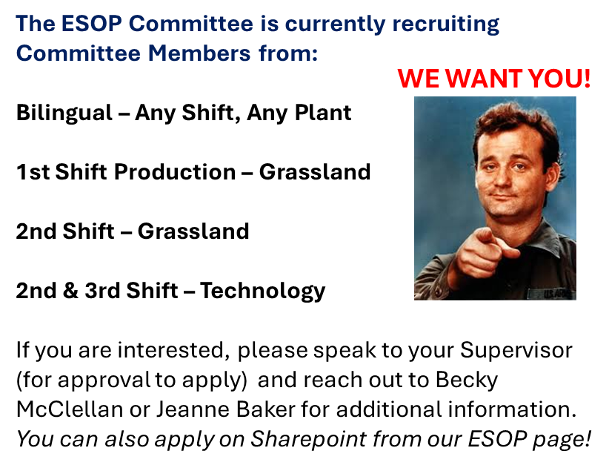
February
Announcements, Events & Anniversaries
UPCOMING EVENTS
Mar 1 - 4/1 👕 Hourly, Supervisor, TL Shirt Order Period
March 14: 🥧 3.14 Pi Day
March 15 🗡️ The Ides of March
March 15 – 4/6 🏀 March Madness!
March 16 🏛️ Joel Town Hall (Tech)
March 17 🍀 St. Patrick’s Day
March 28 🍀 Time of Paddy 5K/10K/13.1
It’s Your Anniversary
“I have six roommates, which are better than friends because they have to give you one month’s notice before they leave.”
- Toby Flenderson
MARCH 2026: ISSUE #3
PAGE 5

Slide 8



COMPANY PROMOTIONS
“Working hard is important. But there is something that matters even more: believing in yourself.”
- Harry Potter
Hear Ye
Hear Ye
The Following Employees Have Been
PROMOTED
Please join us in congratulating the following team members on their recent promotions. We appreciate their hard work, dedication, and continued contributions to our success.
PROFOUND MUSINGS…by Craig
(80’s & 90’s pop culture edition)
Leadership
Brinley Nopper | Team Leader
Sarah Dailey | Team Leader
Production
Gavin Ganci | Refrigeration Tech
Leydi Rodriquez Perez | Electrical Tech
Reynaldo Alzuaga | Refrigeration Tech
Engineering & Design
Bruce Bergin | R&D Electrical Engineer
Michael Dwyer | Quality Management System Engineer
Gregory Boyd | Designer II
Support & Technical
Katia Bartutis | Parts Order Clerk
Melissa Hidalgo | Quality Tech
Forget the Jets and stuff, the coolest part of Top Gun was when Tom Cruise looked at his watch in slow motion.
I’ll never understand how Teen Wolf, who was a WAREWOLF (!!) became the most popular kid in school just because he could dunk a basketball.
Do you think when a young Lieutenant Crunch was promoted, and someone accidentally referred to him as LT, he said, “actually….I’ve been promoted….it’s Captain Crunch”.
Bonnie Tyler asked her boyfriend to turn around 7 different times in the song Total Eclipse of the Heart. Poor guy’s out here spinning like a top.
Serious question: On Saved by the Bell, who managed the Malibu Sands Beach Club when summer ended and Mr. Belding had to go back to being a principal?
“You miss 100% of the shots you don’t take. – Wayne Gretzky”
- Michael Scott
MARCH 2026: ISSUE #3
PAGE 6

Slide 9

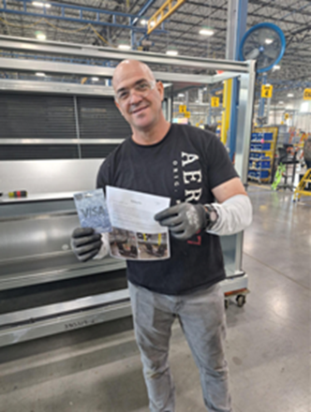
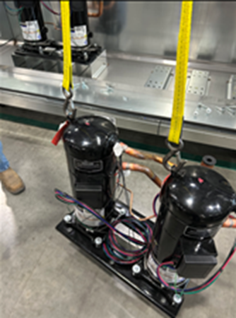
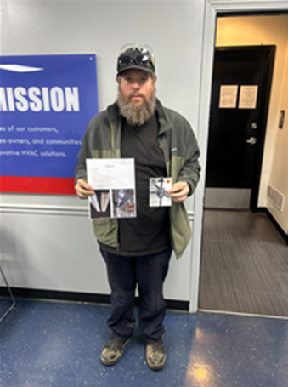
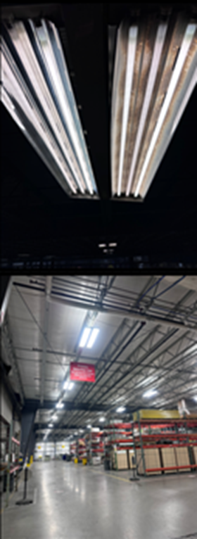
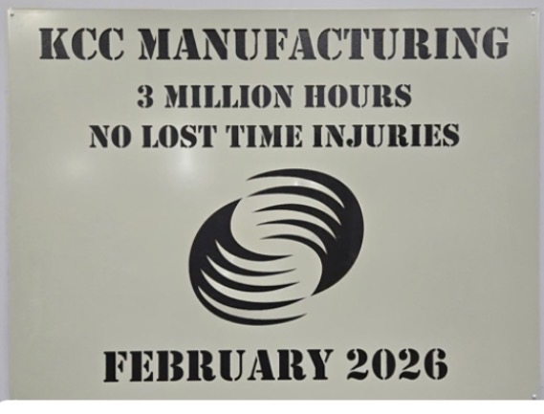
SAFETY FIX OF THE MONTH
WINNERS
January 2026
Alexis Arevalo Rodriguez
Line D HVAC Assembly
Alexis Arevalo Rodriguez is an assembly tech for Line D at the Technology Facility. Alexis installs compressors into units with the use of a crane. While performing a tandem lift for dual compressors, Alexis recognized the hooks on the lifting device were too large to safely secure the load. He brought this safety concern to the safety team and proper hooks were provided to securely install the compressors!
GREAT FIX!
The Safety Committee has awarded Alexis with the Safety Fix of the Month and a $50 gift card. Congrats to Alexis!
YOU COULD BE NEXT!!!
Mike Orangias
Grassland Maintenance
Mike is a maintenance team member at the Grassland facility. Mike noticed the lamps in the rear of the building were not providing adequate lighting. The dim bulbs were an issue for forklift drivers and pedestrians in the area. Mike responded by using a scissor lift, with appropriate fall protection, to update 476 lamps!
GREAT FIX!
The Safety Committee has awarded Mike with the Safety Fix of the Month and a $50 gift card. Congrats to Mike!
YOU COULD BE NEXT!!!
We are proud to announce an extraordinary achievement:
KCC has surpassed 3 million work hours without a lost time injury.
This milestone reflects far more than a number — it represents a daily commitment to safety, accountability, and looking out for one another. Every employee, every shift, and every decision has contributed to creating a workplace where safety comes first.
MARCH 2026: ISSUE #3
PAGE 7

Slide 10
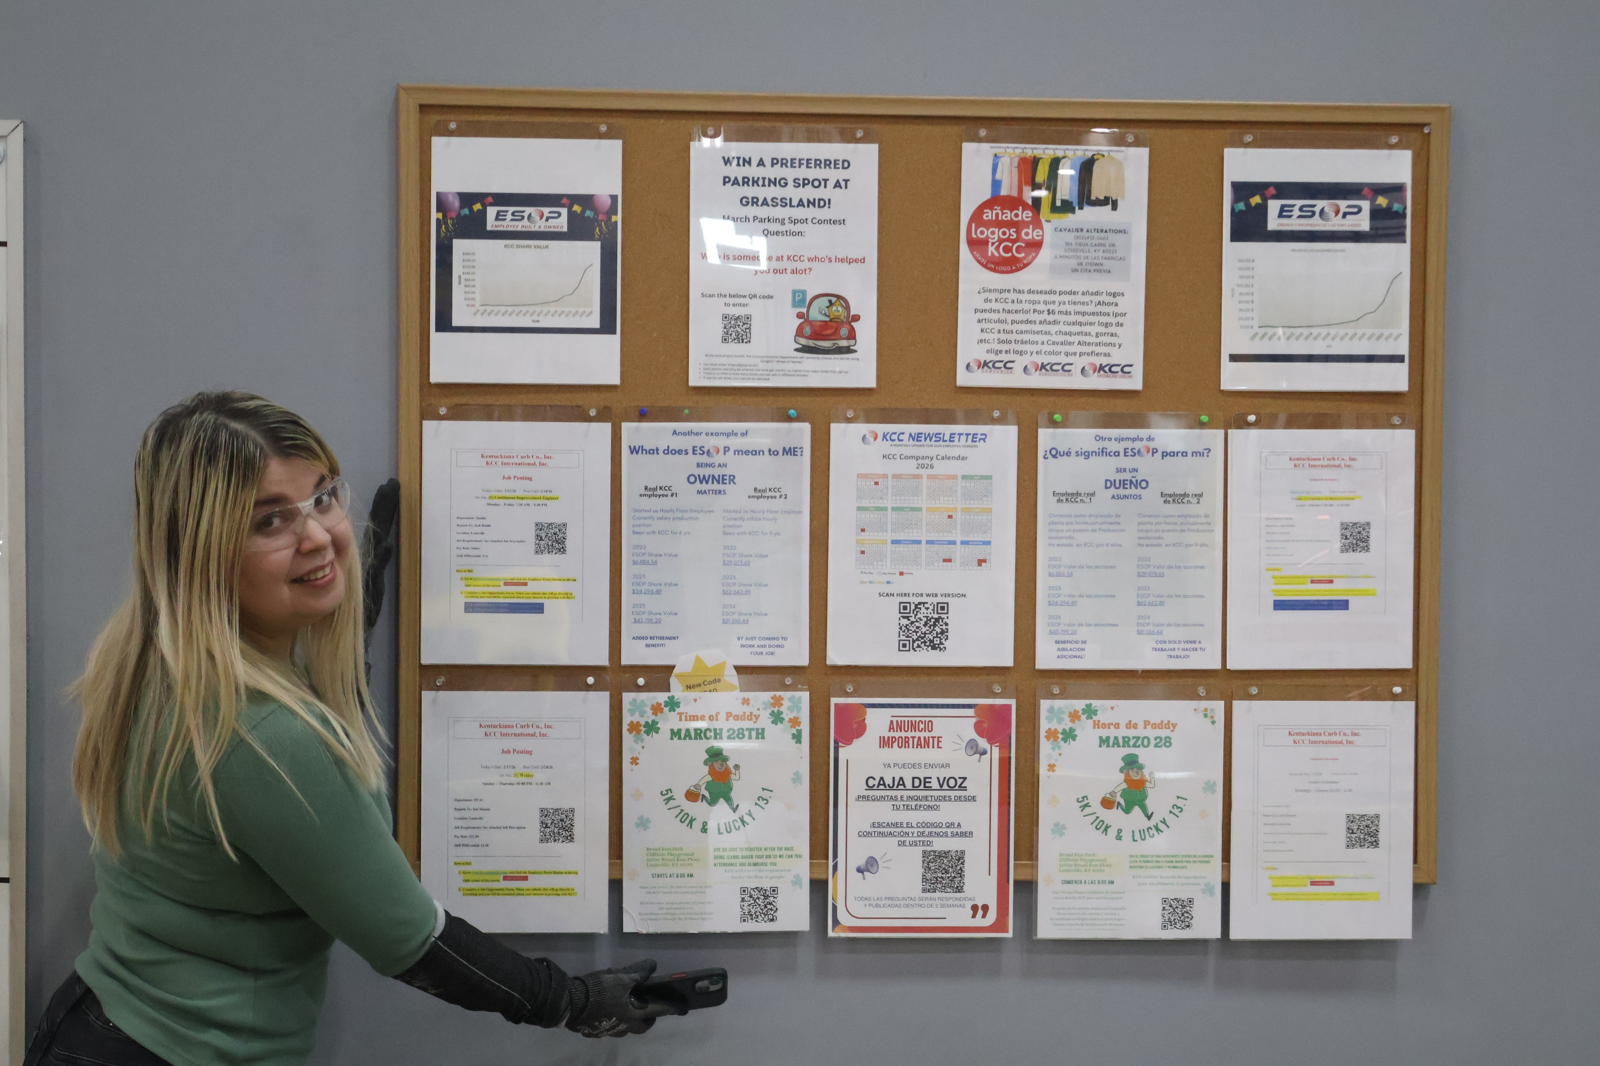
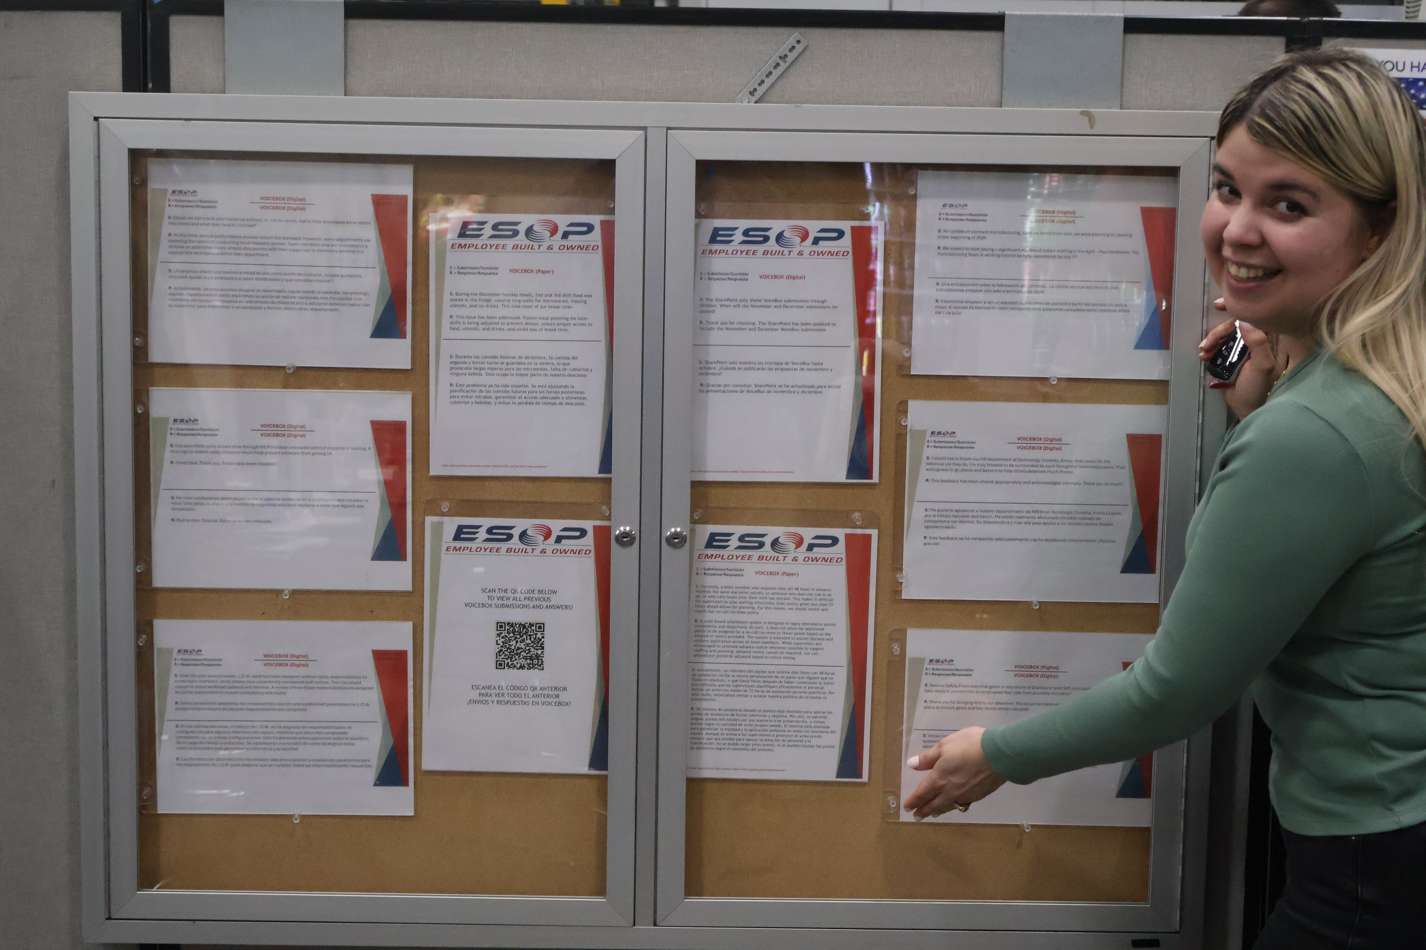
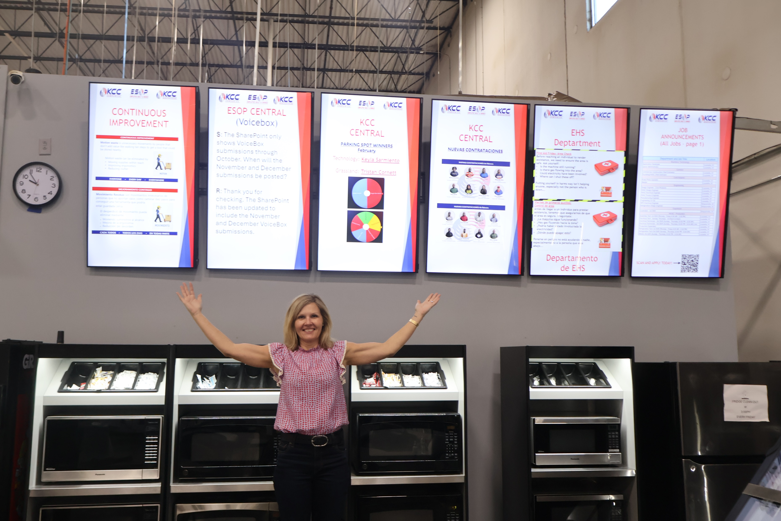
Question of the Month
WHERE DO I FIND COMPANY
RELATED COMMUNICATIONS?
MARCH 2026: ISSUE #3
PAGE 8

Slide 11

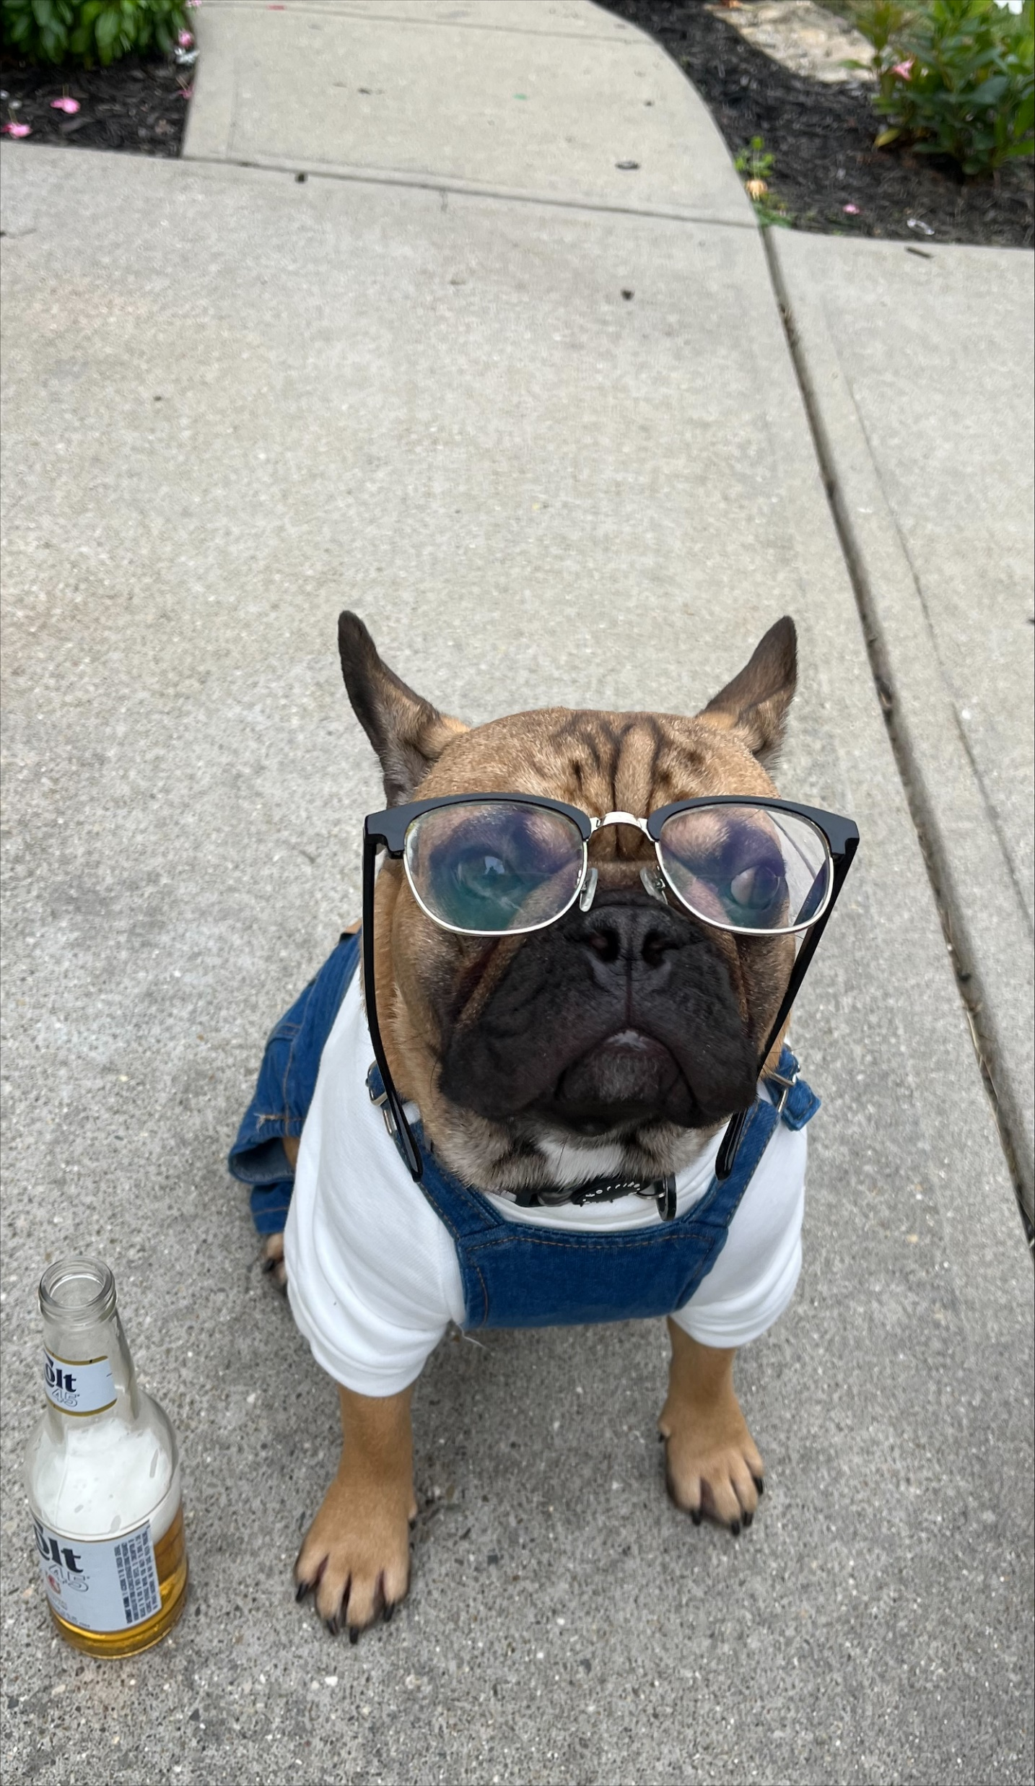
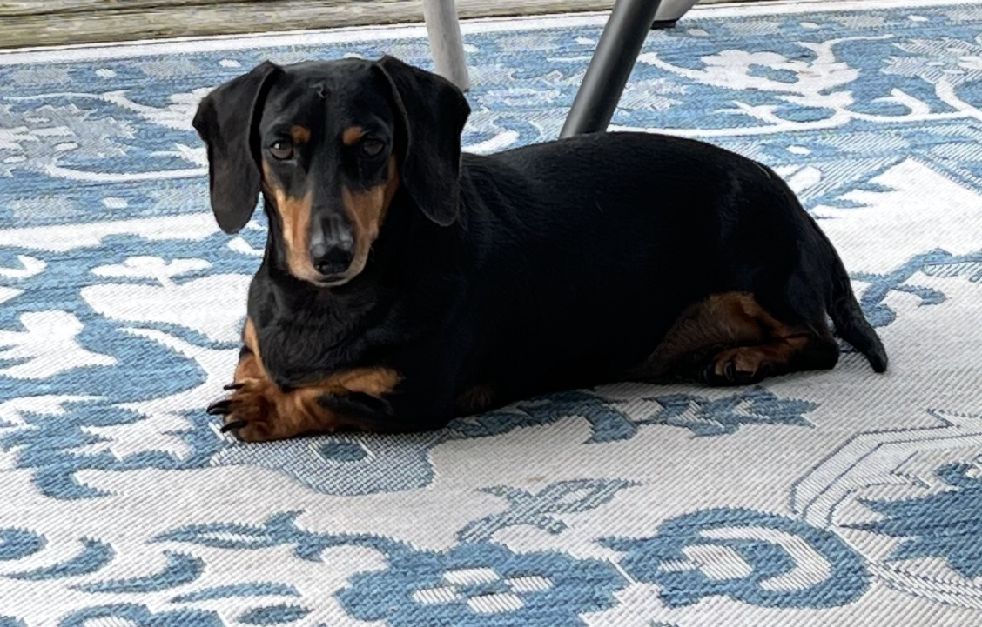
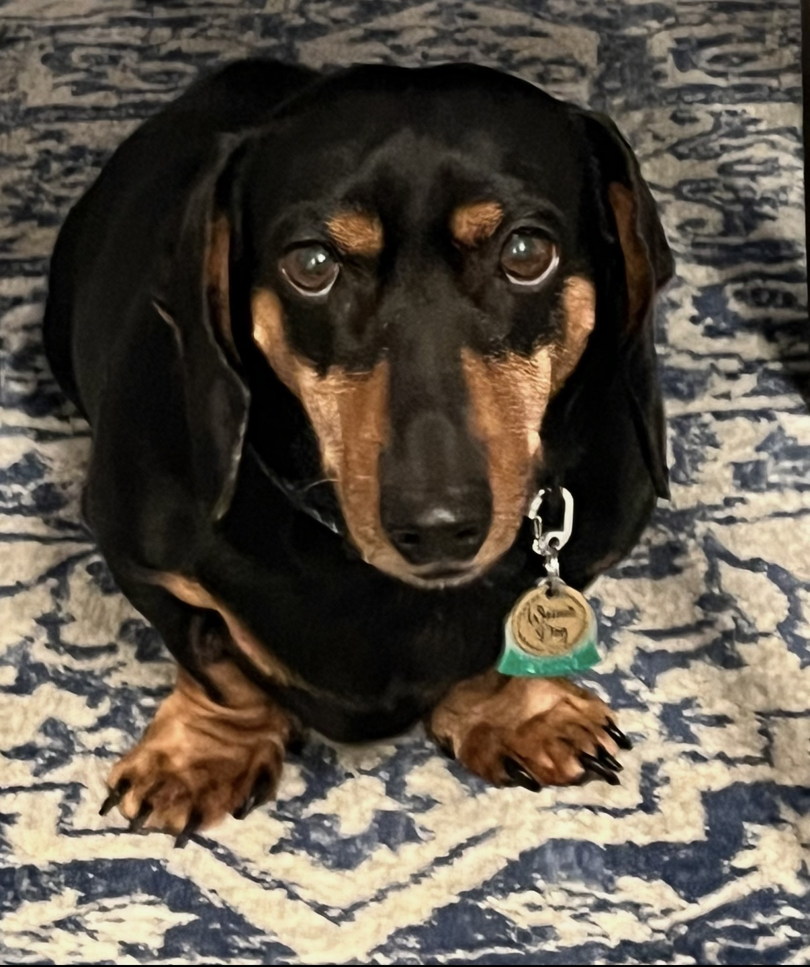
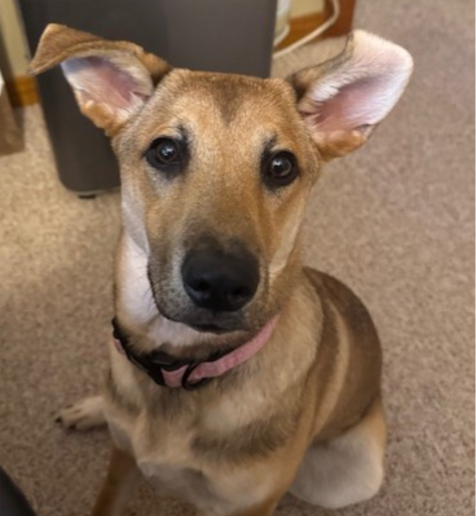
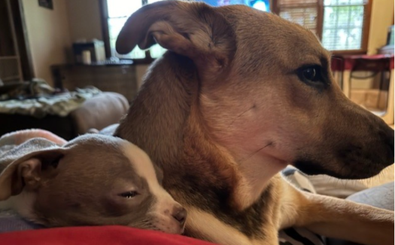
🐶 Pet’s name: BOBA
👤 Owner’s name & department
Sabrina Phelps, Manufacturing Engineering
💬 Fun fact about BOBA: His secret power is ignoring commands (regardless of his large ears) but can hear a cheese wrapper open from a block away!
We want to meet the furry (or feathery… or scaly) members of the KCC family.
Have a pet you’d like to show off? Send us:
📸 A photo of your pet
🐶 Pet’s name
👤 Owner’s name & department
💬 One fun fact (favorite toy, weird habit, secret talent, etc.)
Email submissions to: gjefferson@kccmfg.com and drodriquez@kccmfg.com
Selected pets will be featured in upcoming newsletters!
🐶 Pet’s name: LUNA
👤 Owner’s name & department
Tammy Mayfield, BT
💬 Fun fact about LUNA: Luna was adopted from the Arrow Fund and was featured on the news with her siblings and momma dog. Izzy Hoffman adopted her sister Nina.
🐶 Pet’s name:
WIENER J. DOG
👤 Owner’s name & department
Greg Jefferson, Communications
💬 Fun fact about WJD: Hates rain, likes Georgia football (thinks he’s a bulldog 🙄🙄), constantly plotting to take over the world (between naps).
“Pets are better than people”
-Everyone
MARCH 2026: ISSUE #3
PAGE 9

Slide 12
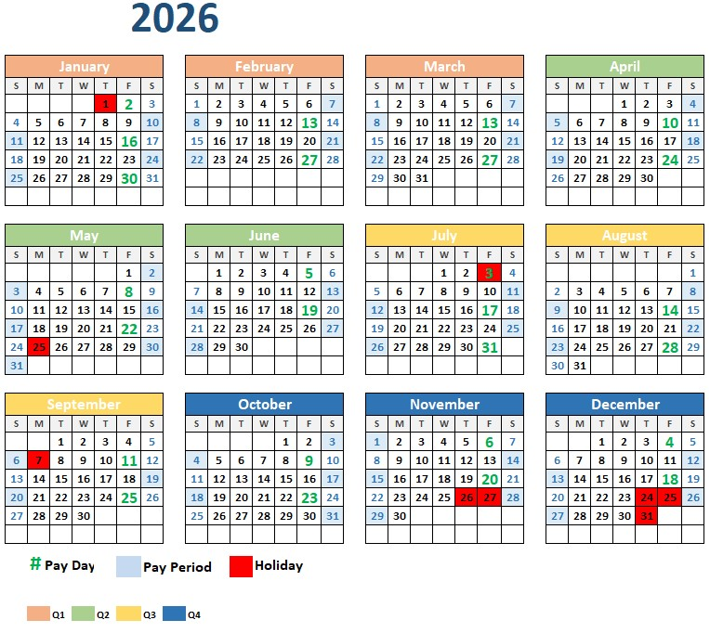



KCC Company Calendar
2026
SCAN HERE FOR WEB VERSION:
MARCH 2026: ISSUE #3
PAGE 10

